Slide 1

Big Mountain Resort
Samuel Kim

Slide 2
Problem Identification
Big Mountain Resort increased their operating costs by $1,540,000 this season; which entails additional chair lift to help increase the distribution of visitors across the mountain.
In result, the pricing strategy has been to charge a premium above the average price of resorts in its market segment.

Slide 3
Problem Identification (cont.)
However, Big Mountain is not capitalizing on its facilities as much as it could. The business wants some guidance on how to select a better value for their ticket price.
They are also considering a number of changes that they hope will either cut costs without undermining the ticket price or will support an even higher ticket price.

Slide 4
Recommendation and key findings
Within the target feature and looking within the graph below we can make a few assumptions. Firstly, there is a clear line where weekend and weekday prices are equal.
Weekend prices being higher than weekday prices seem restricted to sub hundred-dollar resorts.
Big Mountain resort is in Montana, so the relationship between these quantities in this state are particularly relevant.

Slide 5
Recommendation and key findings
The skiable terrain area is negatively associated with ticket price!
It could be an effect whereby larger resorts can host more visitors at any one time and so can charge less per ticket.
As has been mentioned previously, the data are missing information about visitor numbers. Bear in mind, the coefficient for skiable terrain is negative for this model.
For example, if you kept the total number of chairs and fast Quads constant, but increased the skiable terrain extent, you might imagine the resort is worse off because the chairlift capacity is stretched thinner.

Slide 6
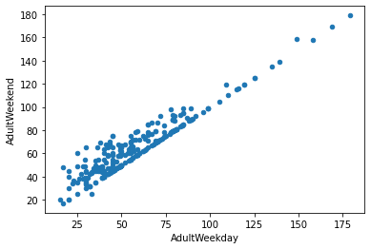
Modeling results and analysis Part 1

Slide 7
Analysis Part 1
Within the target feature and looking within the graph below we can make a few assumptions.
Firstly, there is a clear line where weekend and weekday prices are equal.
Weekend prices being higher than weekday prices seem restricted to sub hundred-dollar resorts.
Big Mountain resort is in Montana, so the relationship between these quantities in this state are particularly relevant.

Slide 8
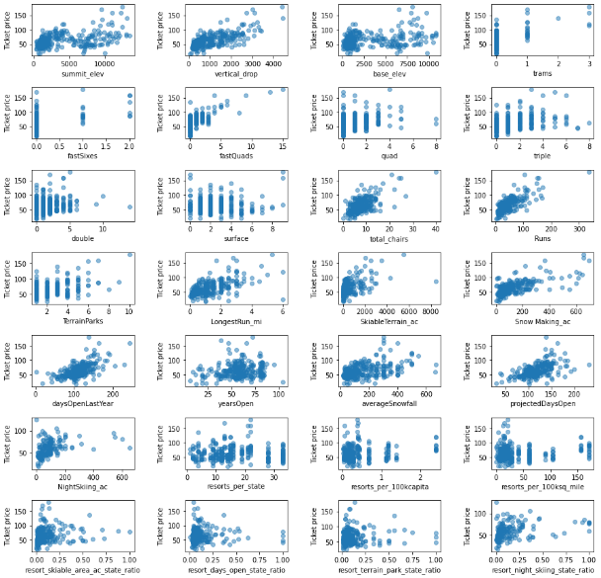
Modeling results and analysis Part 2

Slide 9
Analysis Part 2
There's a strong positive correlation with vertical_drop. fastQuads.
Furthermore, Runs and total_chairs appear quite similar.
However, resorts_per_100kcapita shows something interesting that you don't see from just a headline correlation figure.
When the value is low, there is quite a variability in ticket price, although it's capable of going quite high.
Ticket prices may drop a little before then climbing upwards as the number of resorts per capita increases.
Ticket price could climb with the number of resorts serving a population because it indicates a popular area for skiing with plenty of demand.
The lower ticket price when fewer resorts serve a population may similarly be because it's a less popular state for skiing.
The high price for some resorts when resorts are rare (relative to the population size) may indicate areas where a small number of resorts can benefit from a monopoly effect. It's not a clear.

Slide 10
Conclusion
Big Mountain Resort modelled price is $108.30, actual price is $81.00.
Even with the expected mean absolute error of $10.24, this suggests there is room for an increase. This result should be looked at optimistically and doubtfully!
The validity of our model lies in the assumption that other resorts accurately set their prices according to what the market (the ticket-buying public) supports.
The fact that our resort seems to be charging that much less that what's predicted suggests our resort might be undercharging.
It's reasonable to expect that some resorts will be "overpriced" and some "underpriced."

